Slide 1
COMPAC J4 and OPNAV N4 Logistics System for Distributed Maritime Operations
TEAM TIGER
Coleman Strickland
Leon Tan
Tony Vanderzee

Slide 2
Agenda
Overview
Situation
Tasking
Bottom Line Up Front
Development of Models
Assumptions
Concept of Logistical Support
Analytical Tools and Measures of Effectiveness
Results
Technical Injects
Future Work

Slide 3
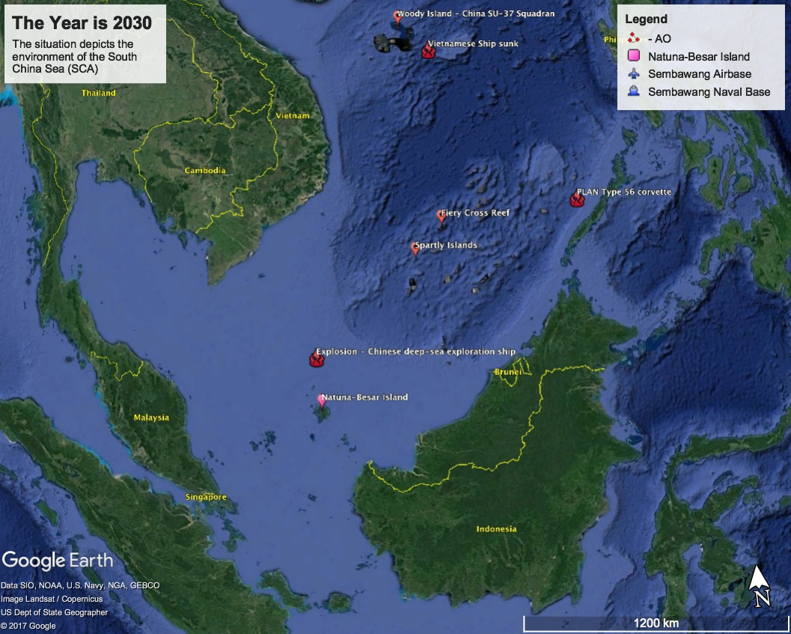
Situation
The Chinese have threatened to assume governorship of the island of Natuna Besar to control the southern approaches to the South China Sea
US and coalition forces have decided to intervene and deter attacks against Natuna Besar
The mission of U.S. forces is to deter attacks against Natuna Besar and Palawan before landings can occur, by holding PLAN ships at risk
Notes:
The year is 2030!
Incidents:
China deep sea exploration ship exploded 100 miles north of Natuna Beser
PLAN Type 56 conduct gunnery exercise near Plawan
The Chinese have just sunk a patrolling Vietnamese ship in the South China Sea near Woody Island
The YJ-83 is a Chinese subsonic anti-ship cruise missile. It is manufactured by the China Aerospace Science and Industry Corporation Third Academy.
Range of 180 km (111 miles)

Slide 4
Tasking
Given a distributed maritime operations concept where contributions to sea control are made by joint, combined, and coalition partners – Fleet Tactical Grid
COMPAC J4 and OPNAV N4
Design an expeditionary and distributed logistics system to support the distributed operations at sea
Maximize fuel and ammunition available
Minimize risk to logistics forces
Assess unconventional ideas such as the civilian afloat fuel commodities market
Notes:
Admiral Hyman Rickover, the ”father” of the nuclear Navy, understood that “Bitter experience in war has taught the maxim that the art of war is the art of the logistically feasible.” All of America’s naval force depends upon supply and logistics to carry out the full spectrum of operations, naval logistics bridges the gap between land bases and depot and forces at sea.
The Combat Logistics Force is critical to that capability to sustain forward presence, sea control, power projection, and extended combat across the range of military operations.

Slide 5
Bottom Line Up Front
One T-AOE and one T-AKE can support a Carrier Strike Group and two Surface Action Groups through the gas station refueling method during operations with increased tensions in the South China Sea.
Two T-AOEs and two T-AKEs can support these same forces with delivery boy refueling during an increased operational tempo, but will be at a 94% utilization rate, unsustainable for continuous operations.
By adding two CLF-5000s to the logistics fleet, utilization of resupply ships drops to 56%.
Notes:
One T-AOE and one T-AKE can support a Carrier Strike Group and two Surface Action Groups with varying composition through gas station refueling method during a distributed maritime operation with increased tensions in the South China Sea.
Two T-AOEs and two T-AKEs can support these same forces with delivery boy refueling during an increased operational tempo, but will be at 94% utilization which is unsustainable.
The development of the Combat Logistics Ship (CLF-5000) which augment existing logistics force structure can improve the supportability of a distributed maritime operations. Adding two CLF-5000 to the 7th fleet drops logistics utilization to 55% in a wartime setting.

Slide 6
Assumptions
Geographic/Location Assumptions:
US and coalition forces are defending and deterring attacks at Natuna Besar
US Allies in region
Singapore
Sembawang Naval Base
Philippines
Subic Bay
Vietnam
Cam Rahn Bay
Brunei
Royal Naval Base
Logistics Assumptions:
7th Fleet as the baseline for demand
1 x Carrier Strike Group (CSG): 1 x CVN, 3 x DDG, 1 x CG
1 x Surface Action Group (SAG): 3 x DDG
1 x Surface Action Group (SAG) : 1 x DDG, 2 x CG
Re-supply of fuel and ammunition only
Fuel consumption rate and ammo consumption rate remain constant in each scenario
Time to resupply will be based on distance and amount of fuel/ammo needed
Surface ships signal for resupply at 75% fuel or ammo availability

Slide 7
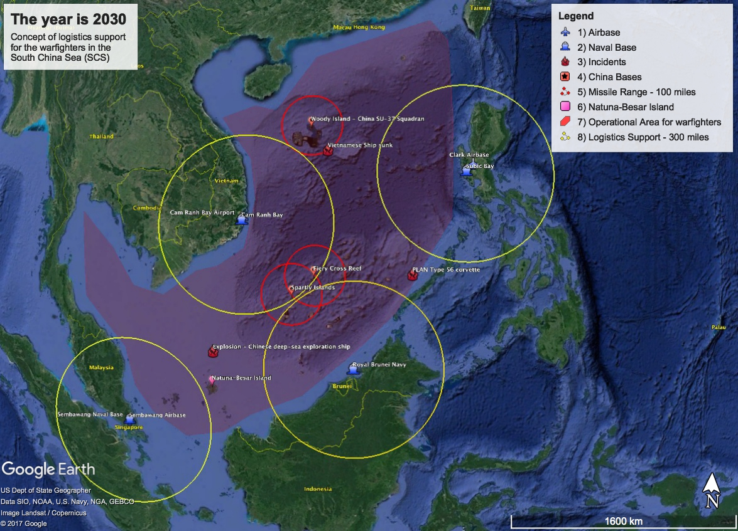
Concept of Logistics Support
Notes:
4 land based hubs
Sembawang Terminal, Singapore
Subic Bay, Philippines
Cam Rahn Bay, Vietnam
Royal Navy Base, Brunei
3 Airfields
Sembawang Air Base, Singapore
Clark Air Force Base, Philippines
Cam Rahn Air Base, Vietnam

Slide 8
Analytical Tools and MOEs
Model Development:
Logistics Network
Incorporate Circulation Model
Built in SimpleKit using Python and analyzed data with Excel and Python
Simulation Parameters:
Simulation was based on 60 days of continuous operations with steady-state reached at 14 days
Ships will be distributed randomly in the respective ‘bounding box’
Measures of Effectiveness:
Consumption of surface ships
Fuel provided (barrels)
Ammunition provided (tons)
Utilization of Surface Ships
% of time on/off station
Utilization of Supply Ships
% of time ship is conducting resupply

Slide 9
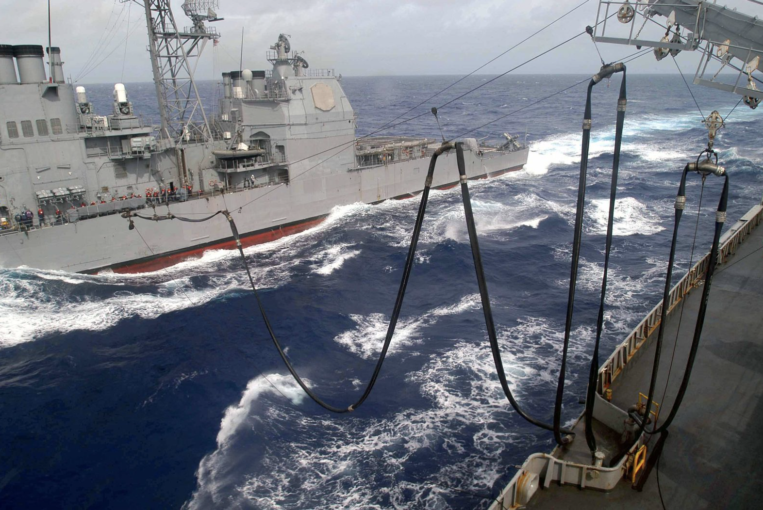
Model Development
Scenario
Operational environment
Means
Type of support (Gas Station vs. Delivery Boy)
Increased tensions short of war
Type of resupply ships
Demand of logistic support
Increased readiness operations
T-AOE
T-AKE
CLF

Slide 10
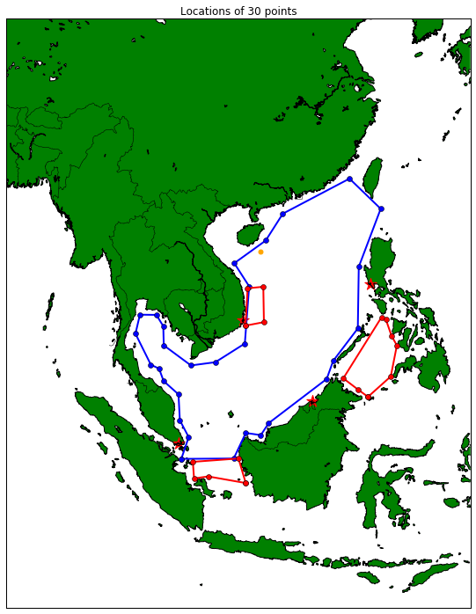
Simulation Scenario #1: Gas Station Refueling
Concept of Support - Gas Station Refueling:
Increased tensions short of war
Surface ships travel to secure resupply locations for refueling and rearming
Variation of quantity of supply ships
Fast Support Combat Ship (T-AOE)
Lewis and Clark (T-AKE)
Assumptions:
Surface ships are scheduled for resupply every 96 to 144 hours
Once a resupply is scheduled, the surface ship is guaranteed to be resupplied
Refueling locations are secure from enemy attack
Resupply ships will resupply at the logistic base closest to the resupply area

Slide 11
Simulation Scenario #1: Gas Station Refueling
Logistics Demand
 | Case # 1 | Case # 2 | Case # 3
Carrier Strike Group (CSG) | 1 | 1 | 1
Destroyer (DDG) | 4 | 4 | 4
Cruiser (CG) | 2 | 2 | 2
Variation of Supply Ships
 | Case # 1 | Case # 2 | Case # 3
Fast Support Combat Ship (T-AOE) | 2 | 2 | 1
Lewis and Clark (T-AKE) | 2 | 1 | 1
Results:
50% drop in the quantity of resupply ships does not equate to a sizable decrease to the amount of fuel and ammo provided to the surface ships

Slide 12
Simulation Scenario #1: Gas Station Refueling
Variation of Supply Ships
Results:
Utilization rate of the resupply ships triples with a 50% reduction in the quantity of resupply ships available.
As the number of resupply ships decreases, the utilization rate of the surface ships decreases because they must wait for a resupply ship to become available.
 | Case # 1 | Case # 2 | Case # 3
Fast Support Combat Ship (T-AOE) | 2 | 2 | 1
Lewis and Clark (T-AKE) | 2 | 1 | 1

Slide 13
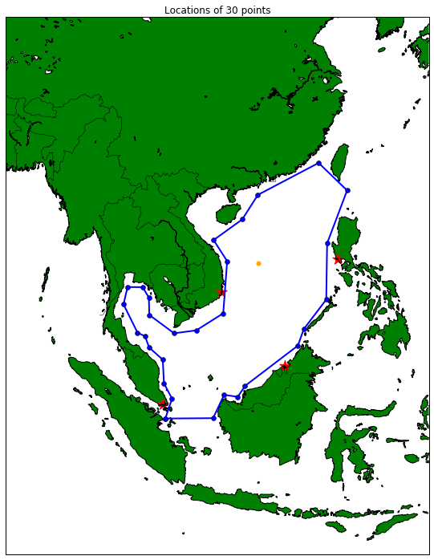
Simulation Scenario #2: Delivery Boy Refueling
Concept of Support - Delivery Boy Refueling :
Option to increase combatant on station time to increase readiness
Resupply ships travel to surface ship locations inside the AOR for refueling and rearming
Variation of quantity of platforms
Fast Support Combat Ship (T-AOE)
Lewis and Clark (T-AKE)
Assumptions:
Surface ships are scheduled for resupply every 48 to 72 hours (increase operational tempo)
Resupply ships are placed in a circulation model with a half leg survivability of 0.98
Resupply ships are escorted by LCS’s

Slide 14
Simulation Scenario #2: Delivery Boy Refueling
Logistics Demand
 | Case # 1 | Case # 2 | Case # 3
Carrier Strike Group (CSG) | 1 | 1 | 1
Destroyer (DDG) | 4 | 4 | 4
Cruiser (CG) | 2 | 2 | 2
Variation of Supply Ships
 | Case # 1 | Case # 2 | Case # 3
Fast Support Combat Ship (T-AOE) | 2 | 2 | 1
Lewis and Clark (T-AKE) | 2 | 1 | 1
Results:
50% drop in the quantity of resupply ships reduces the amount of fuel and ammo provided by 13%.

Slide 15
Simulation Scenario #2: Delivery Boy Refueling
Variation of Supply Ships
Results:
Utilization rate of the resupply ships is maxed with a 50% reduction in the quantity of resupply ships available.
On station time of the surface ships remain constant with Delivery Boy Refueling, giving 10% to 15% improvement over Gas Station Refueling.
Increased risk:
1 x T-AKE and 1 x T-AOE lost in Case 1
1 x T-AKE lost in Case 2
Average wait time for resupply:
Case 1: 125.3 hrs (5.22 days)
Case 2: 27.3 hrs (1.14 days)
Case 3: 22.5 hrs (0.94 days
 | Case # 1 | Case # 2 | Case # 3
Fast Support Combat Ship (T-AOE) | 2 | 2 | 1
Lewis and Clark (T-AKE) | 2 | 1 | 1

Slide 16
Simulation Scenario #3: Delivery Boy Refueling with CLF-5000
Concept of Support - Delivery Boy Refueling :
Resupply ships travel to surface ship locations inside the AOR for refueling and rearming
Wartime operations
Variation of platforms
Fast Support Combat Ship (T-AOE) &
Lewis and Clark (T-AKE)
Combat Logistics Ship(CLS-5000)
Assumptions:
Surface ships are scheduled for resupply every 48 to 72 hours (increased operational tempo)
Resupply ships are placed in a circulation model with a half leg survivability dependent on distance to surface ship (table below)
Refueling ships are escorted by LCS’s
Distance (nm) | Half Leg Survivability
distance<500 | 0.98
500<=distance<1000 | 0.96
1000<=distance<1500 | 0.94
1500<=distance | 0.92

Slide 17
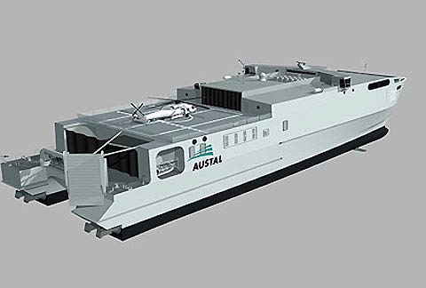
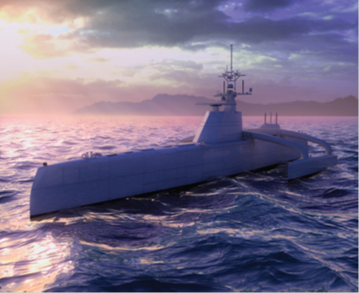
Simulation Scenario #3: Delivery Boy Refueling with CLF-5000
Technical Inject #1: Combat Logistics Ship(CLF-5000)
Fuel Storage Capacity: 2900 barrels
Ammo Storage Capacity: 500 ST
Capable of high speed resupply (max of 35 knots)
Technical Inject #2: Medium Displacement Unmanned Surface Vessel (MDUSV)
Self-deployed surface unmanned system capable of on station times of 60-90 days with ranges of 900 to 10,000 nm
Speed (3-24 knots)
Supplement for DDG or CG

Slide 18
Simulation Scenario #3: Delivery Boy Refueling with CLF-5000
Variation of logistics demand
 | Case # 1 | Case # 2 | Case # 3
Carrier Strike Group (CSG) | 1 | 1 | 1
Destroyer (DDG) | 4 | 3 | 2
Cruiser (CG) | 2 | 2 | 2
MDUSV | 0 | 1 | 2
Results:
Addition of the MDUSV decreased the overall fuel and ammo provided by 29% and 22% respectively.

Slide 19
Simulation Scenario #3: Delivery Boy Refueling with CLF-5000
Variation of Supply
Results:
Utilization rates of surface ships remained consistent for all cases.
The introduction of the CLF substantially reduces the average utilization rates of the resupply ships (decrease of approximately 50% from Scenario 2).
Increased risk:
1 x T-AOE and 1 x CLF lost in Case 1
1 x T-AOE and 1 x CLF lost in Case 2
1x CLF lost in Case 3
Average wait time for resupply:
Case 1: 21.31 hrs (0.88 days)
Case 2: 25.6 hrs (1.06 days)
Case 3: 23.5 hrs (0.98 days
 | Case # 1 | Case # 2 | Case # 3
Fast Support Combat Ship (T-AOE) | 2 | 2 | 1
Lewis and Clark (T-AKE) | 2 | 1 | 1
Combat Logistic Ship (CLF-5000) | 4 | 3 | 2

Slide 20
Future Work
Conduct analysis to determine true survivability of resupply ships in a wartime environment
Implement logistics concept of support within a campaign model simulation
Include uncertainty (i.e. weather and sea state effects on logistic supportability)
Conduct analysis of concept of support in other geographical regions

Slide 21
Questions

Slide 22
Backup slides

Slide 23
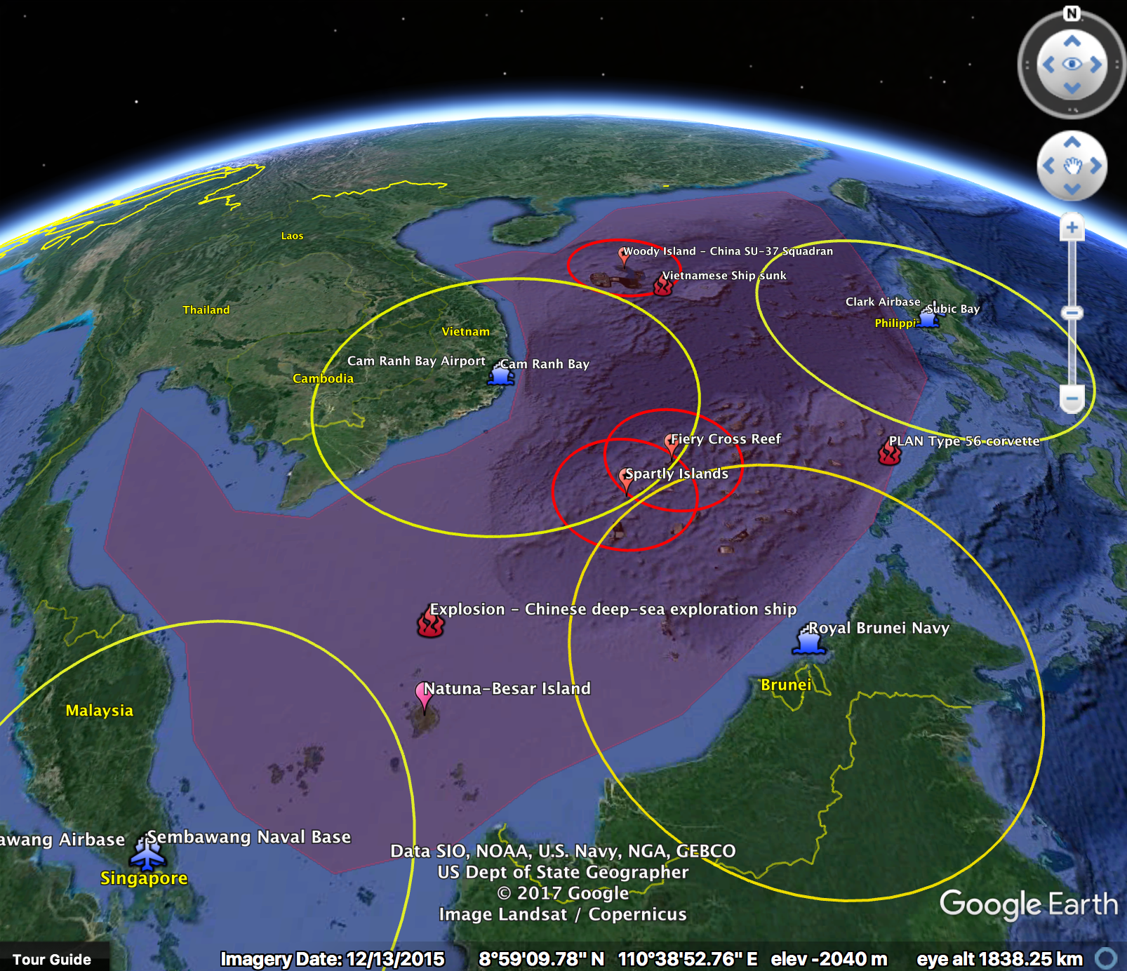
Operational Area Size
Area of Operations
Perimeter: 4923 miles
Area: 929 square miles

Slide 24
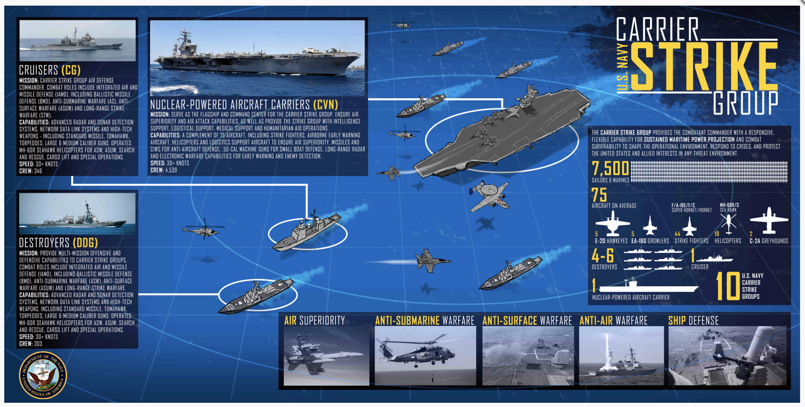
CSG Composition

Slide 25
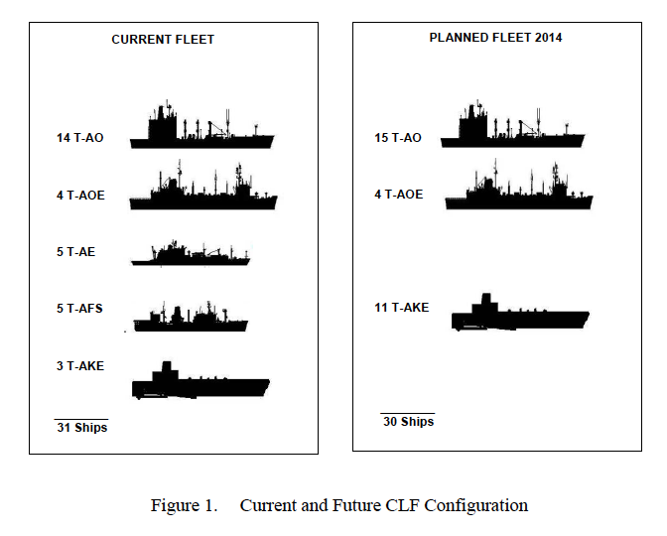
Supply Ships Composition Morse 2008, Optimization of Combat Logistic Force required to support major combat operations

Slide 26
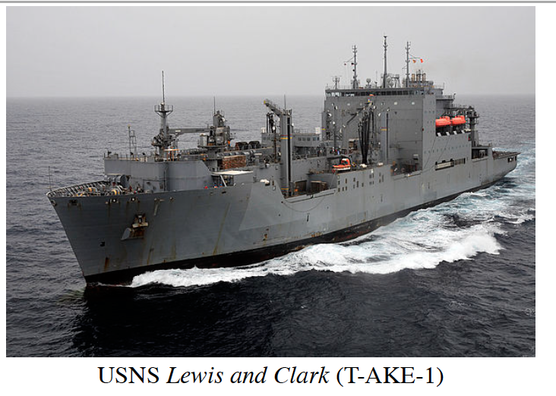
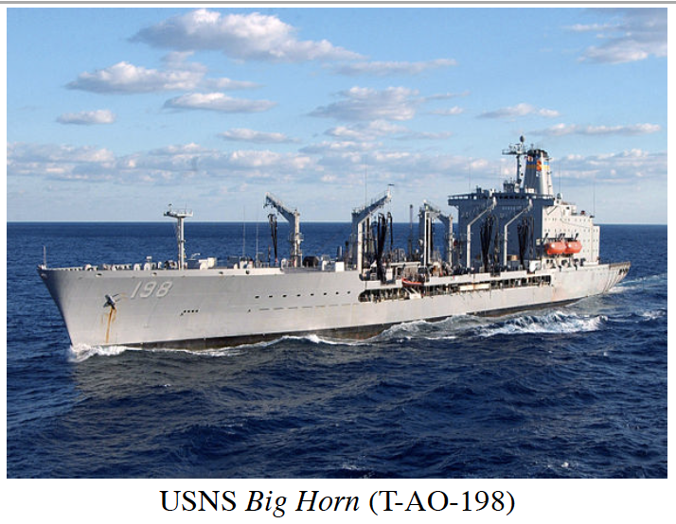
Ships

Slide 27
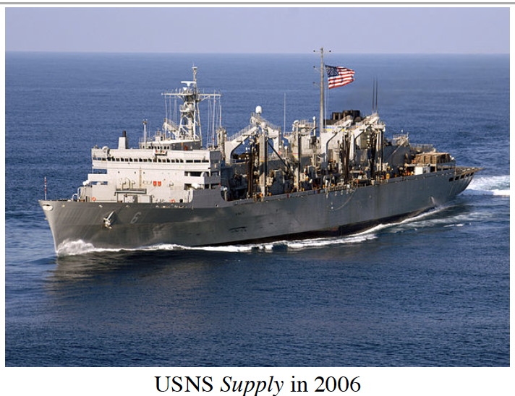
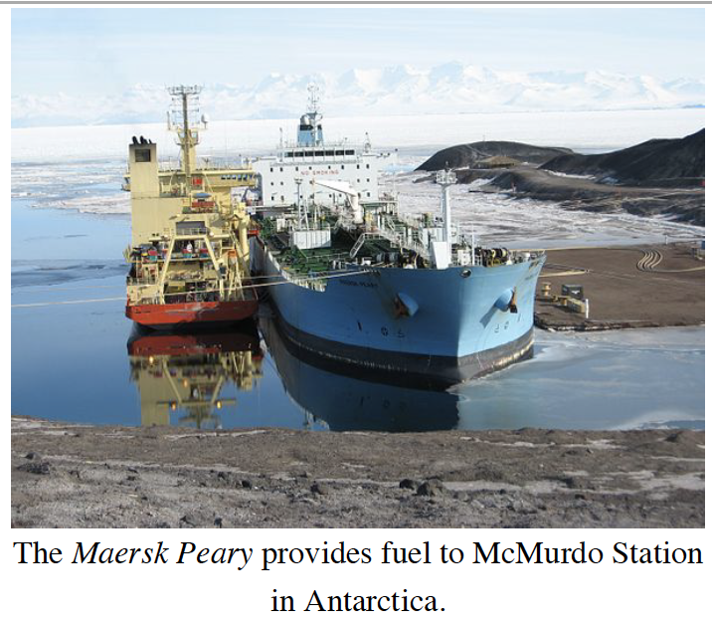
Ships

Slide 28
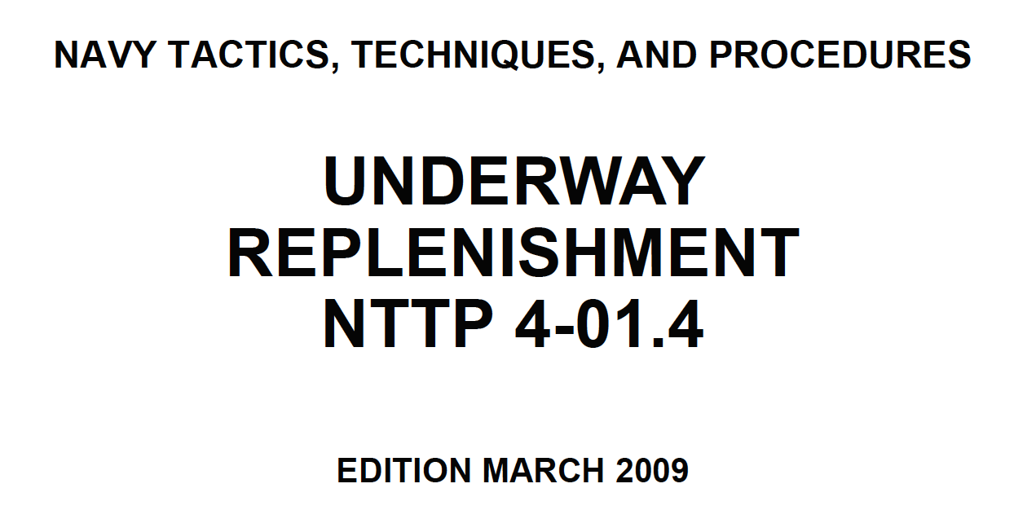
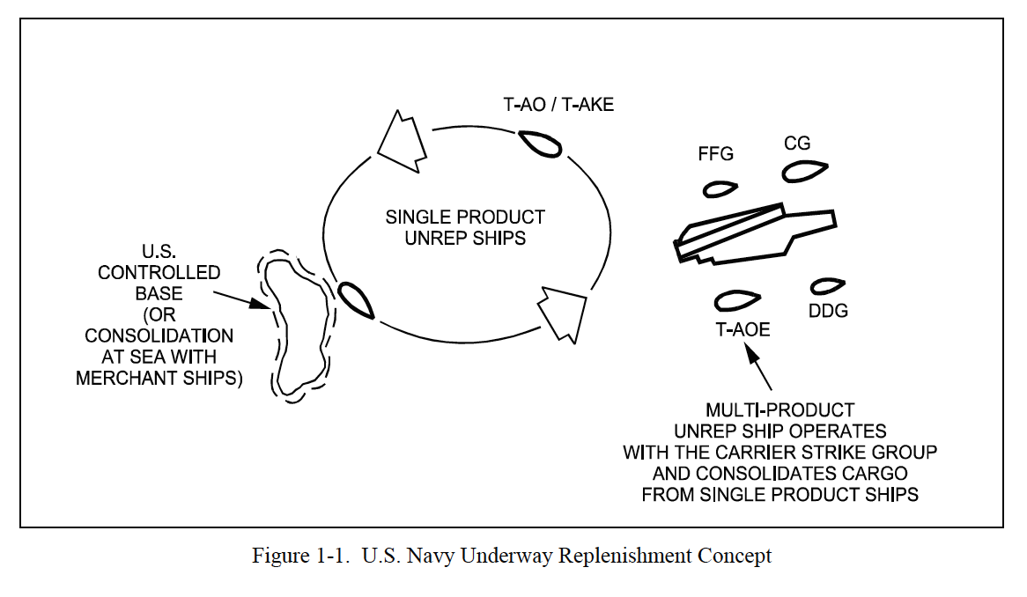
TTP

Slide 29
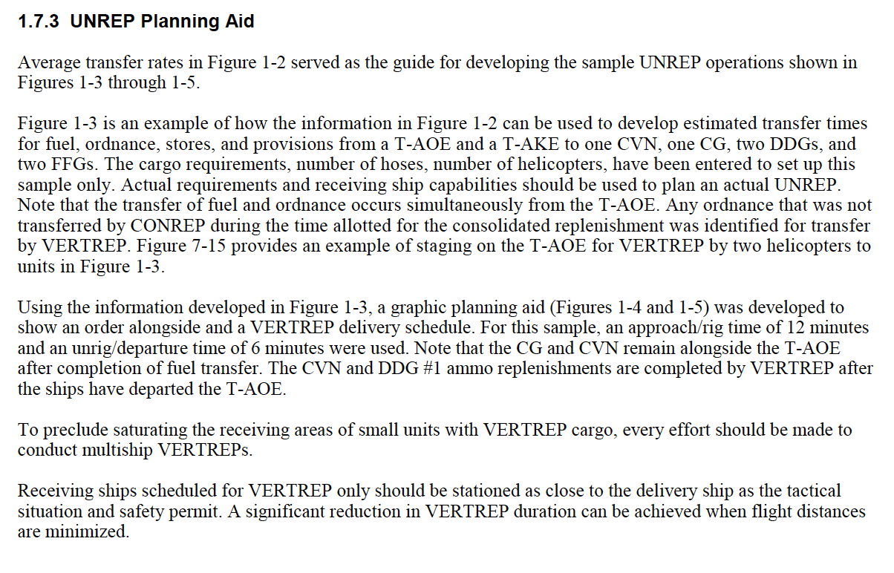
Planning Norms

Slide 30
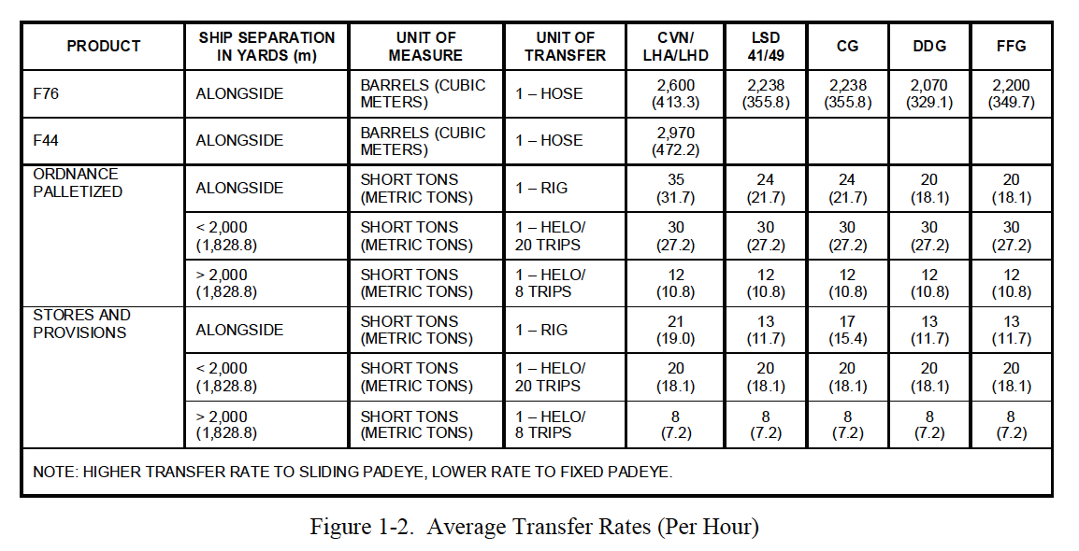
Average Transfer Rates

Slide 31
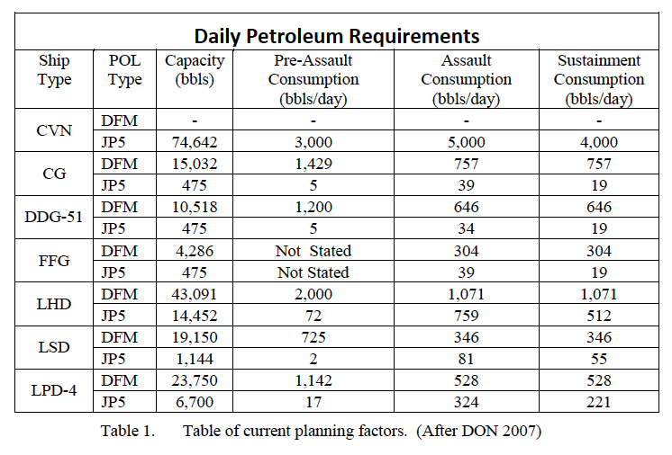
Consumption Rates Long 2011 Optimizing Logistics Planning factors for fuel rate consumption within the fifth fleet area of responsibility

Slide 32
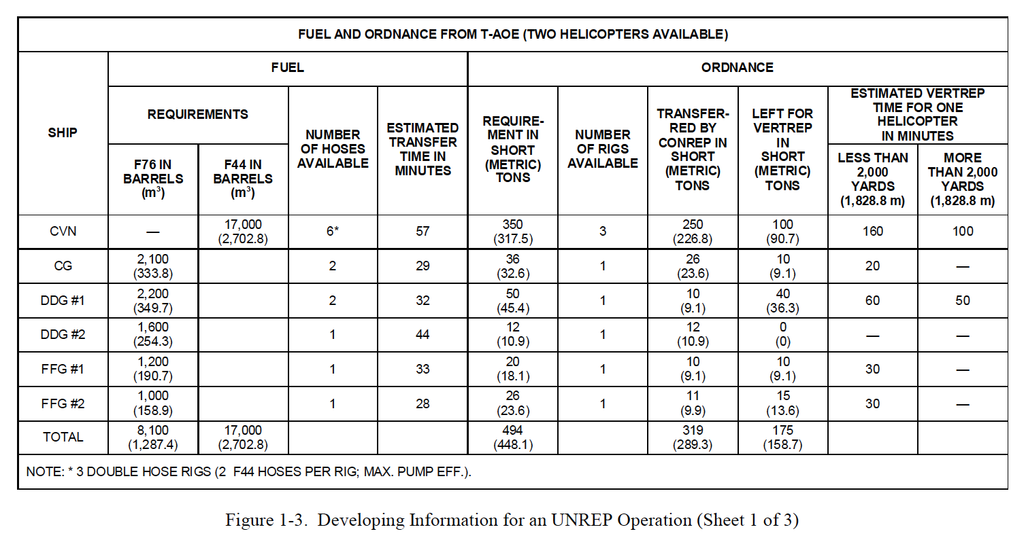
Planning Info

Slide 33
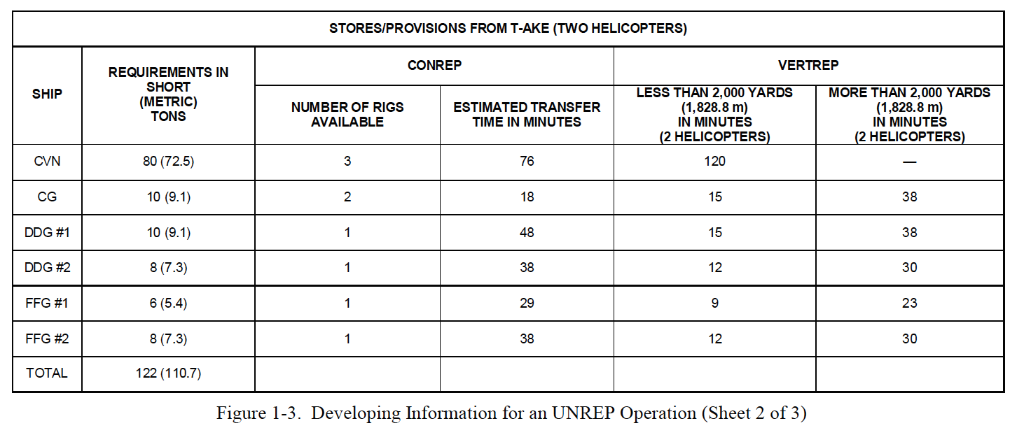
Planning Info

Slide 34
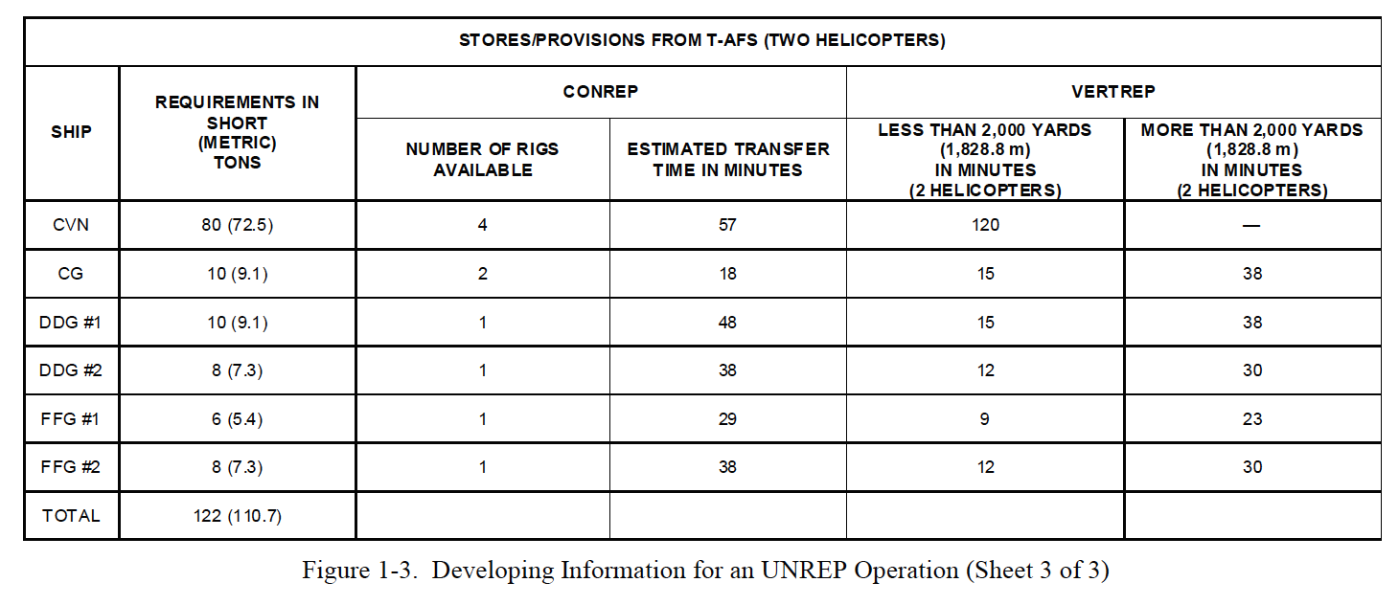
Planning Info

Slide 35
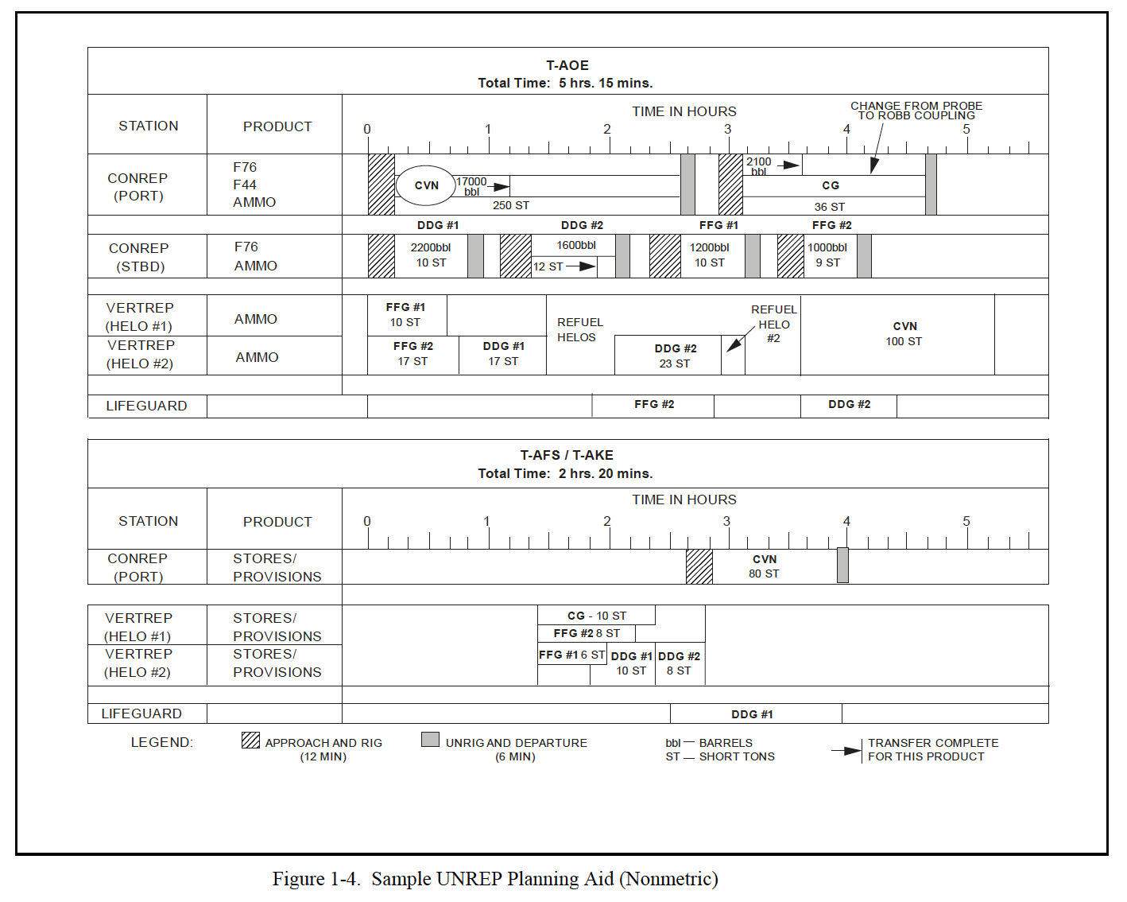
Planning Info

Slide 36
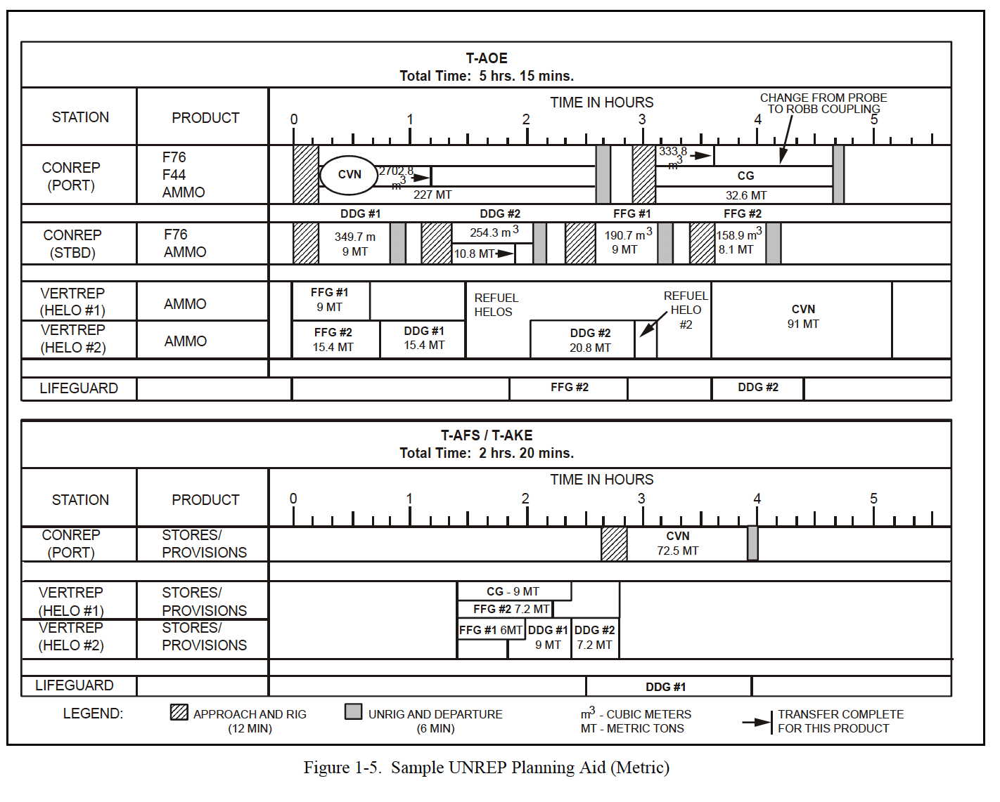
Planning Info

